Slide 1
LAB - 04
陳培殷
國立成功大學 資訊工程系

Slide 2
Outline
Video preview for 可忽略項+反及閘電路+反或閘電路
sum of product
期中考複習

Slide 3
LAB I
Please
(a) simply F with K-map and implement them with sum-of-product.
(b) implement the circuit on the breadboard.
F(A,B,C,D)= (0, 1, 2, 5, 8, 10) with don’t care condition
d(A,B,C,D)= (4, 6)
Notes:
說明要化到最簡

Slide 4
LAB I
(a) simply F with K-map and implement them with sum-of-product.
F(A,B,C,D)= (0, 1, 2, 5, 8, 10) with don’t care condition
d(A,B,C,D)= (4, 6)
Notes:
說明要化到最簡

Slide 5
Components needed for LAB I
Names | Amount
Solerless Breadboard | ×1
74LS04 | ×1
74LS08 | ×1
74LS32 | ×1

Slide 6
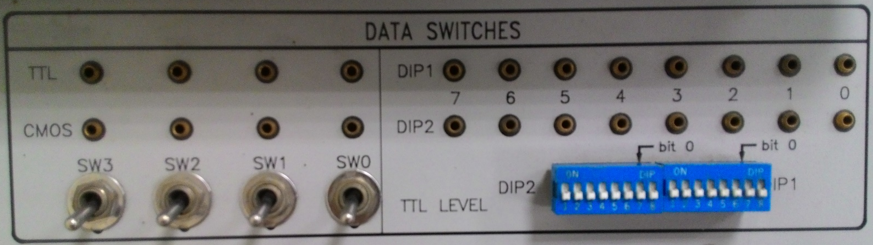
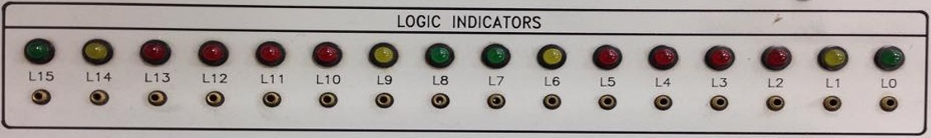
Notice for LAB I
Input
Output
A
B
C
D
F
Notes:
錯誤：Input的框框錯(已修正)

Slide 7
LAB II
(a) simply function F with K-map and draw the NAND logic diagram of it:
F(A,B,C,D)=A’B’C+AC’+ACD+ACD’+A’B’C’
Notes:
可以拿掉LAB II

Slide 8
Components needed for LAB II
Names | Amount
Solerless Breadboard | ×1
74LS00 | ×1
74LS04 | ×1

Slide 9
Notice for LAB II
Input
Output
A
B
C
D
F
Notes:
錯誤：Input的框框錯(已修正)

Slide 10
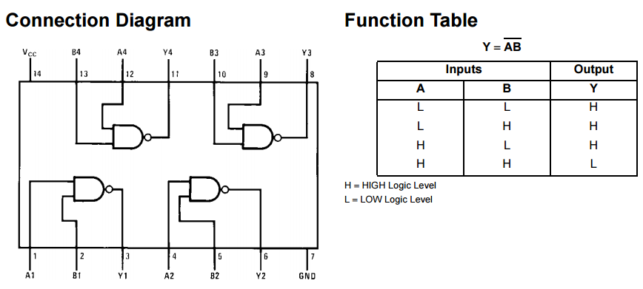
74LS00

Slide 11
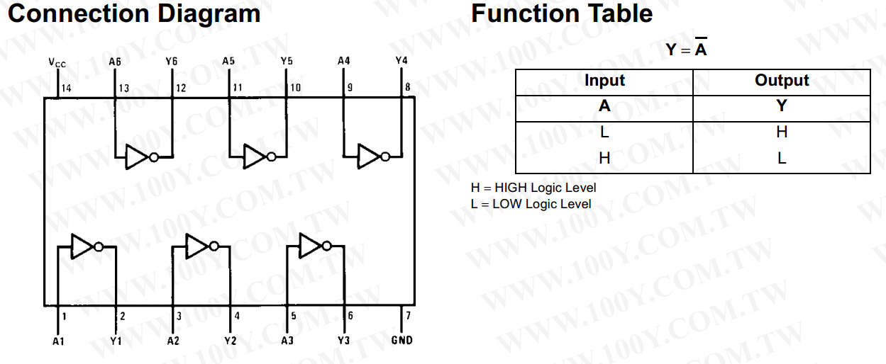
74LS04

Slide 12
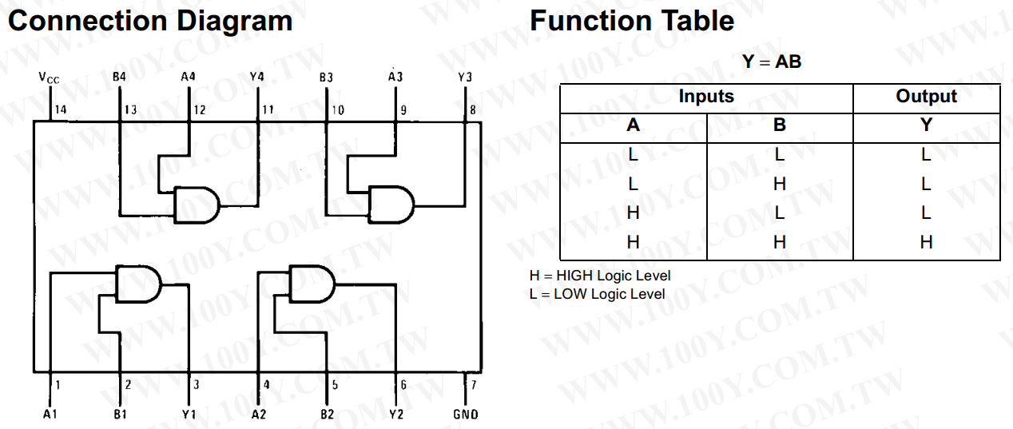
74LS08

Slide 13
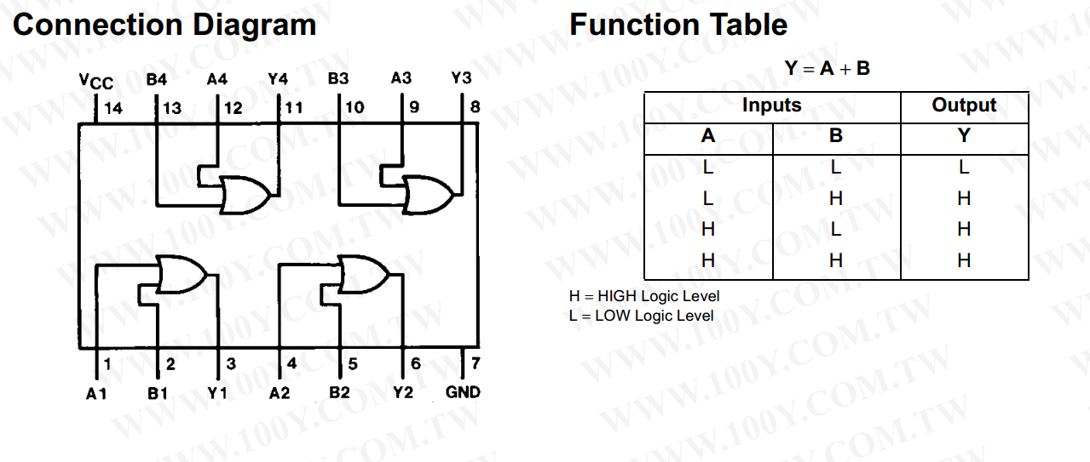
74LS32

